Slide 1
Beer and Breweries Case Study
Banu Pullaiahnaidu and Kenya Roy​
February 21, 2023
Notes:
Thank you for pointing us in the right direction to use the Beers and Breweries datasets pulled from the company repository. We pulled these datasets into RStudio and conducted an extensive exploratory data analysis for your review. We expect that Budweiser could benefit from gaining insight on our findings as you seek to get a greater understanding of the landscape of Breweries and Beer production in the US. For context, we looked at breweries and beers across the country by state and style with a specific focus on key beer characteristics including Alcohol By Volume and International Bitterness Unit.
The following graphics are derived from the code we wrote on RStudio. The code is not included in the presentation slides, but we are more than happy to send you the Rmd file after the presentation.
First, we want to discuss the distribution of breweries across the country.

Slide 2
Agenda
Introduction
Address Missing Values
Review Dataset: Breweries in US by State
Review Summary Statistics
Identify Relationship of ABV and IBU
Identify Relationship of ABV and IBU in Ale and India Pale Ale (IPA) Beer Styles
Conclusion
Notes:
How many breweries are present in each state?

Slide 3
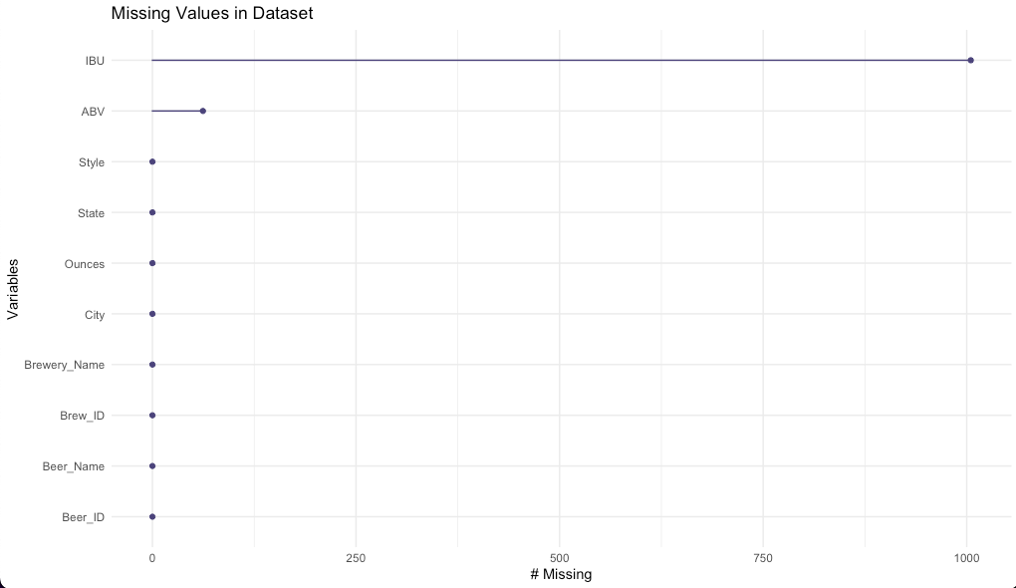
Missing Values
Dataset name: Beers
The dataset has N=2410 rows and 7 columns. 1405 rows have no missing values on any column.
Dataset name: Breweries
The dataset has N=558 rows and 4 columns. 558 rows have no missing values on any column.
Conclusion
We determined that the missing IBU and ABV values were missing completely at random (MCAR) because we found that no other variable (State, Style, Ounces) impacted the probability of missingness.
Methodology: Imputation
Using our domain knowledge, we learned that every style of beer has a range of IBU and ABV values. We determined that imputation would be the best method of addressing missing values as opposed to listwise deletion.
We then used the mean IBU values and mean ABV values by style of beer to impute missing values.
Notes:
•MCAR: The probability of missing does not depend on the data ... the covariates: Gender, Age or Income itself. It is as if the wind blew away records at random and Male and Female, Old and Young and High, Low and Medium salaries were all equally likely to by blown away (missing).

Slide 4
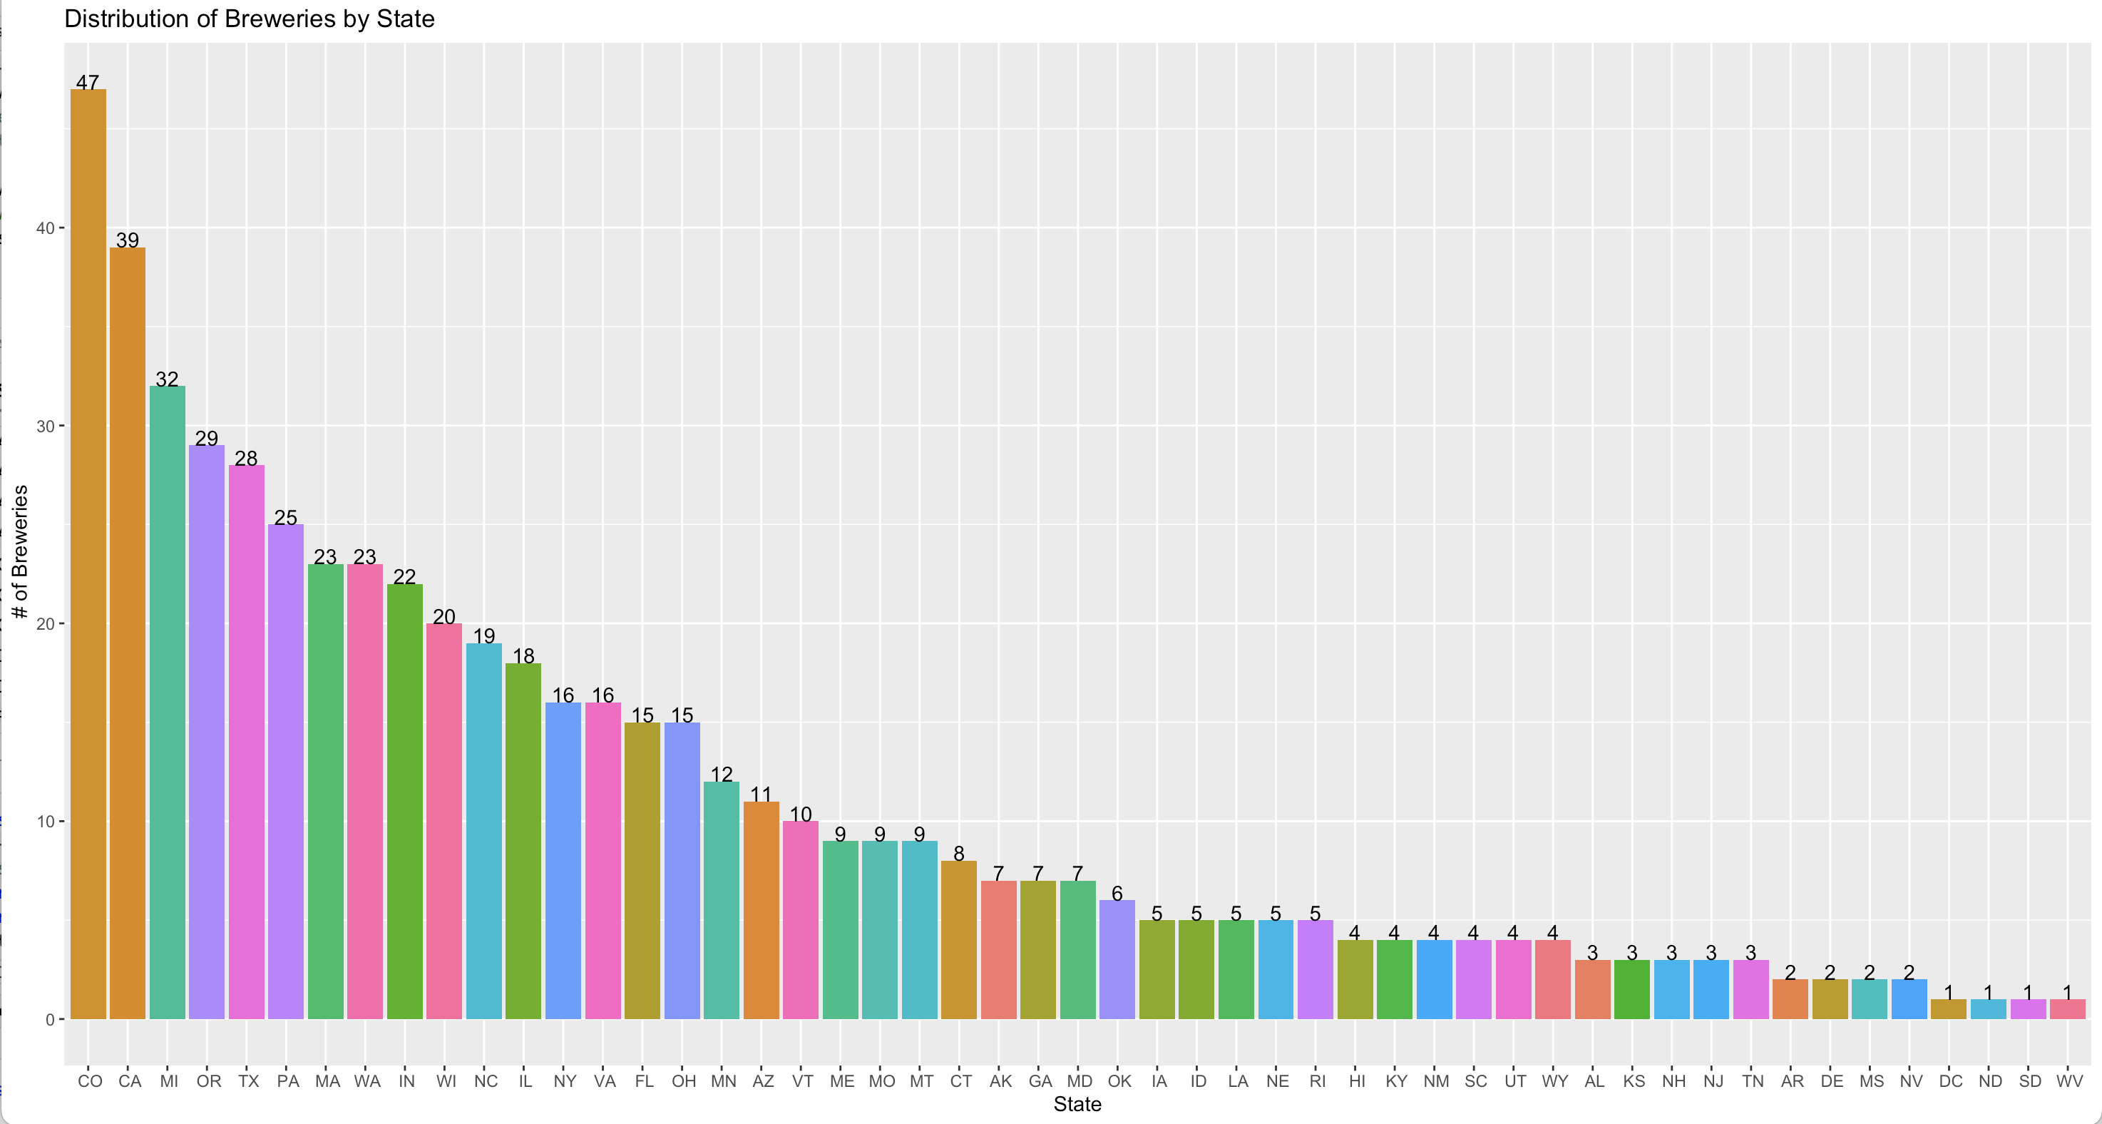
Breweries Per State
Notes:
How many breweries are present in each state?

Slide 5
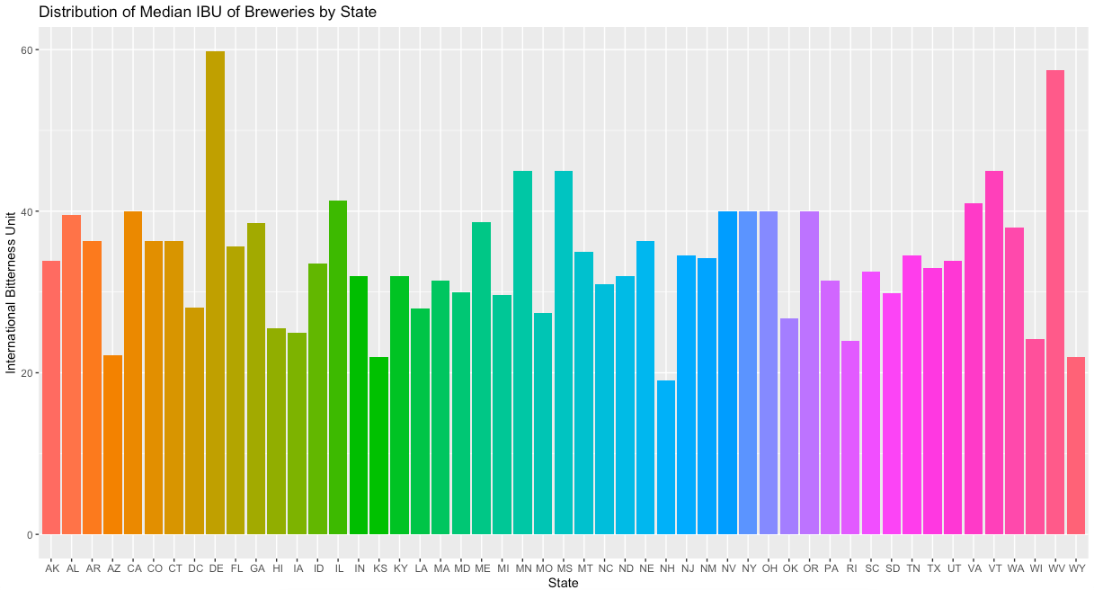
Median International Bitterness Unit by State
Notes:
Median ABV are less varied than median international bitter unit values
There doesn't appear to be much skewness in the IBU data. It has more of a uniform distribution with exception to two states (DE and WV).
Both DE and WV have only two APA beers with high IBU values (median is higher) which skew the distribution.
California and Colorado have many beers....

Slide 6
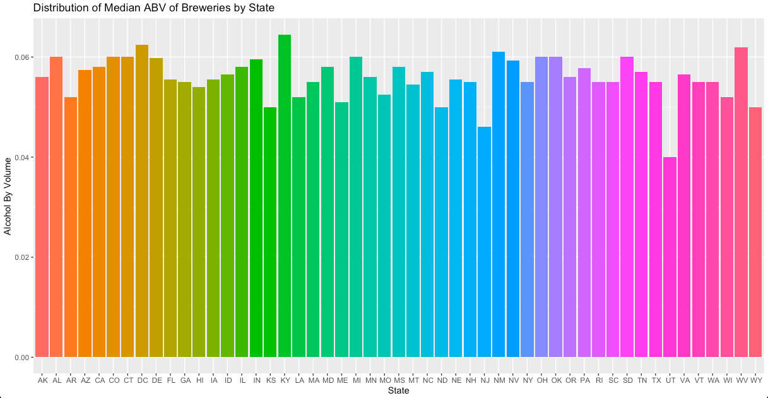
Median Alcohol Content (ABV) by State
Notes:
ABV has more of a uniform distribution with very little peaks. This means that there's a probability that all ABV values are equally likely across states. We'll discuss this further later on in the presentation.

Slide 7
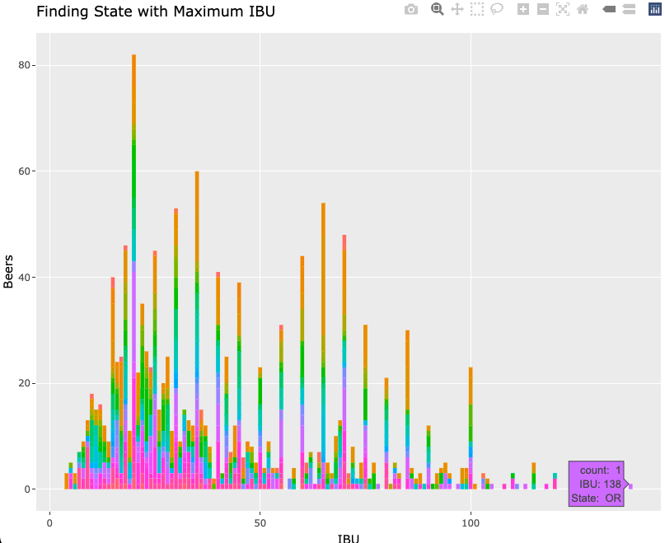
Most Bitter (IBU) Beer in the States
The state with the most bitter (IBU) beer is Oregon.​

Slide 8
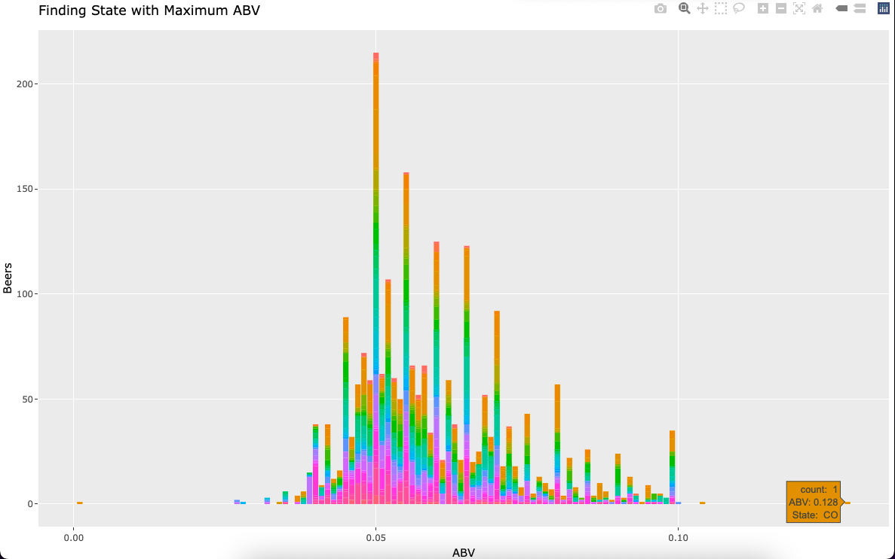
Max Alcohol Volume (ABV) Beer in the States
The state with the maximum alcoholic (ABV) beer is Colorado.​
Notes:
This is a good representation of our ABV values as only 62 values were dropped from the command

Slide 9
Summary Statistics and Distribution of ABV
Min.​ ​ | 1st Qu. ​ | Median ​ | Mean ​ | 3rd Qu. ​ | Max. ​ | Std. Dev.​
0.02700 ​ | 0.05000​ | 0.05600 ​ | 0.05972 ​ | 0.06700 ​ | 0.12800​ | 0.01343​
Outliers: There are few outliers in the ABV data.
Skewness: ABV values have a right-skew distribution
Interquartile Range: 50th percentile of ABV values fall between 0.050 (Q1) and 0.067 (Q3).
(IQR = Q3 – Q1 = 0.017)
Range: The measure of spread is large.
Notes:
The outliers are extreme values, however, 95% of beers fall between .050 and .067

Slide 10
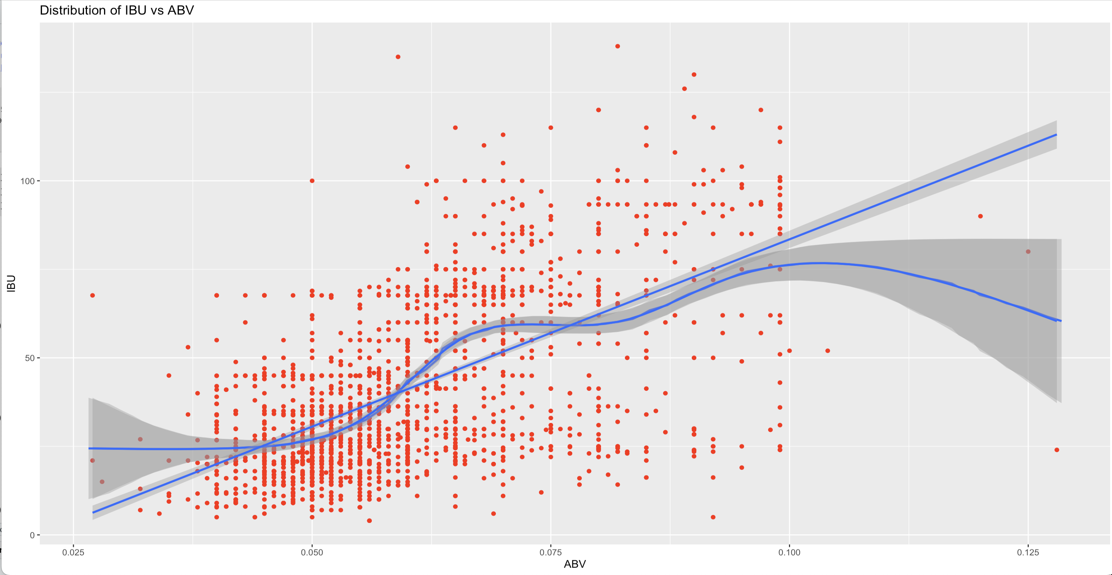
Relationship Between Bitterness and ABV
Notes:
There isn't an apparent relationship. We don't have enough evidence to claim that there is a linear relationship between ABV and IBU in this dataset. There appears to be many beers with high ABV and low IBU values. If there were less of these values, the curve would be higher and would likely show a linear relationship in the scatterplot.
We suspect specific styles are skewing this data. There are many styles of beer in this dataset, specifically 91 styles. It would be interesting to do a case study identifying which style(s) are skewing the distribution of ABV and IBU values.

Slide 11
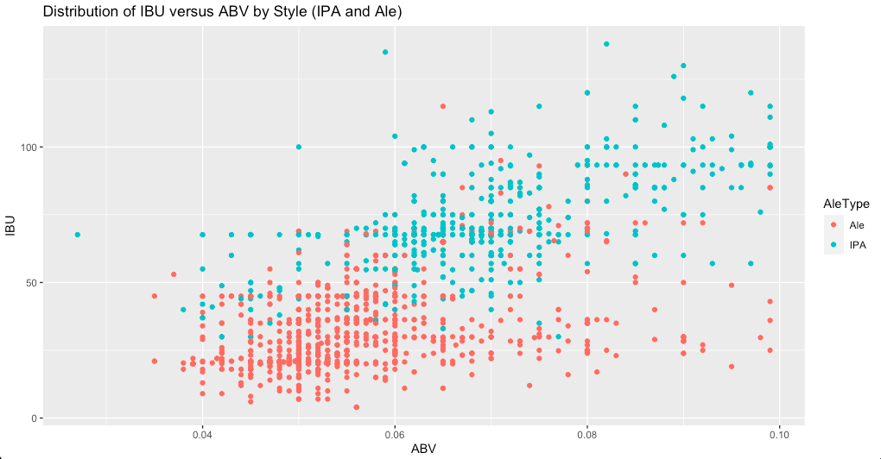
Distribution of IBU versus ABV by Style (IPA and Ale)
Notes:
There isn't an apparent relationship. We don't have enough evidence to claim that there is a linear relationship between ABV and IBU in this dataset. There appears to be many beers with high ABV and low IBU values. If there were less of these values, the curve would be higher and would likely show a linear relationship in the scatterplot.
We suspect specific styles are skewing this data. There are many styles of beer in this dataset, specifically 91 styles. It would be interesting to do a case study identifying which style(s) are skewing the distribution of ABV and IBU values.
IPA's have higher ABV's and IBU's in comparison to Ale beer style.

Slide 12
Accuracy and Classification of IPAs and Ales
Model | Accuracy | Sensitivity | Specificity
KNN | 0.8870 | 0.9199 | 0.8324
NB | 0.8500 | 0.8486 | 0.8523
Model | KNN |  | NB
 | Ale | IPA | Ale | IPA
Ale | 241 | 26 | 264 | 29
IPA | 43 | 150 | 23 | 144

Slide 13
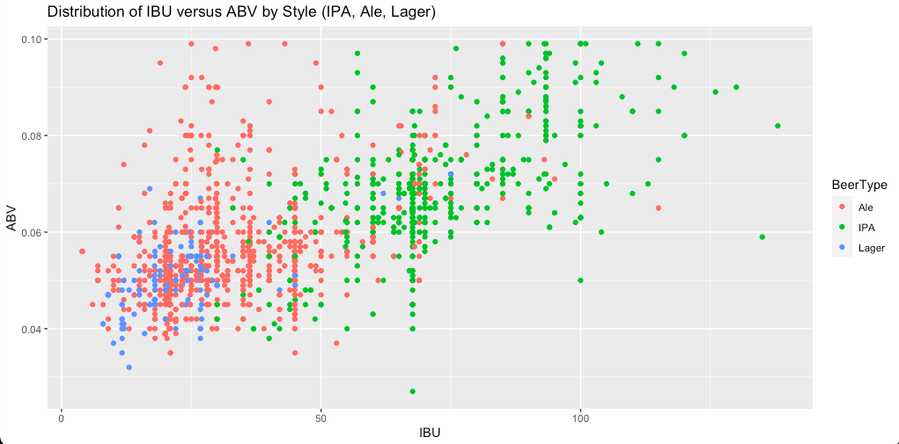
Lagers, IPAs and Ales

Slide 14
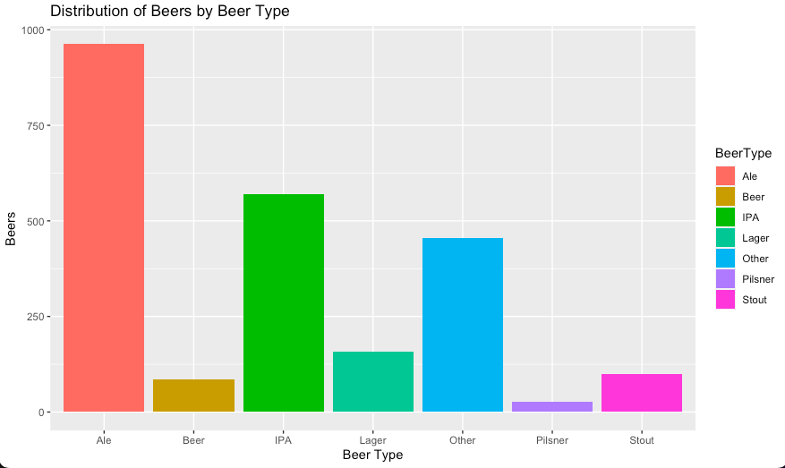
Lagers, IPAs and Ales

Slide 15
Conclusion and Discussion
Contact Kenya Roy (kroy@mail.smu.edu) and Banu Pullaiahnaidu (bpullaiahnaidu@mail.smu.edu) for more information related to this presentation.
Notes:
Close out with main findings, considerations, commitment to continue looking into the subject, if needed. (Include language about pushing the Budweiser project work forward, using data to inform big decisions related to marketing, production, sales).
Leave room for questions and ask for them if needed
3. Include contact information (number and email)

